Slide 1

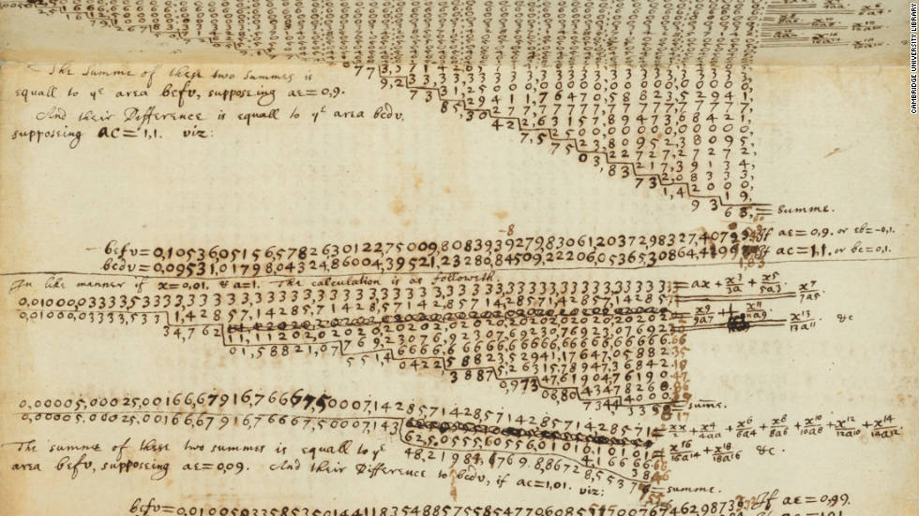
Introduction to Computer Science
Reichman University
Lecture 3-1
Approximation Algorithms
Notes:
‹#›

Slide 2
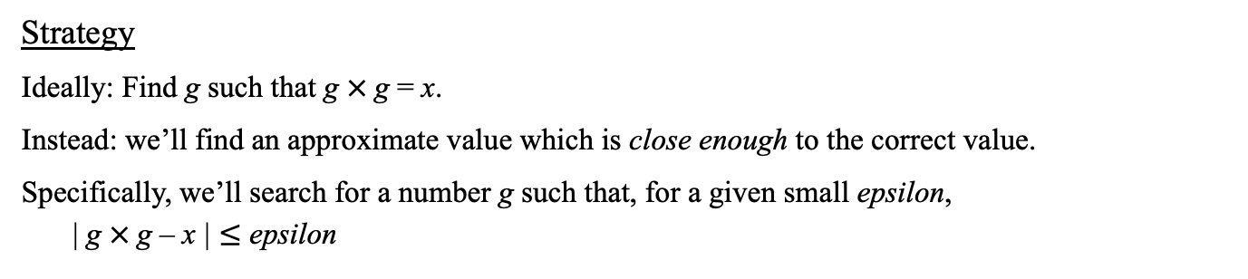
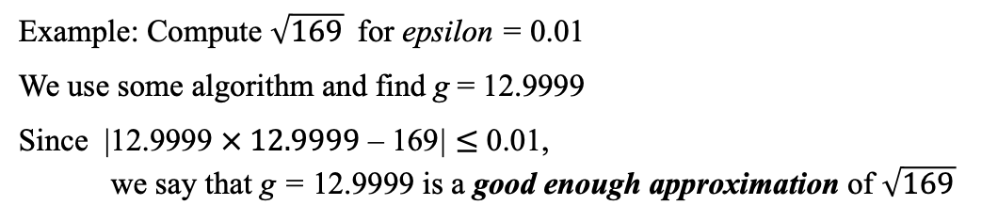
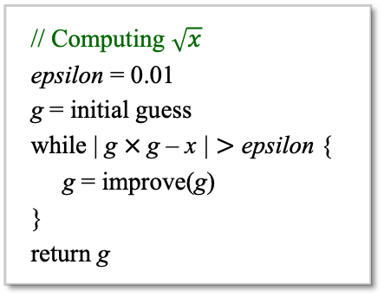
Approximation algorithms
Relevant algorithms
Sequential search
Bisection
Newton - Raphson

Slide 3



Sequential search (“brute force”)
Itr. 0: The square root of x must be between 1 and x, so let’s start with g = 1:
g
1
x
Itr. 1: g = g + increment (increment = a small number, like 0.001)
0
g
x
Itr. 2: g = g + increment
0
g
x
Performance
The smaller is epsilon, the more accurate is the answer
The smaller is increment, the slower is the computation
Running time: Less than x / increment iterations.

Slide 4

Sequential search (“brute force”)
// Computes an approximate square root by sequential search
public class Sqrt1 {
public static void main(String args[]) {
double x = 16; // we’ll find the (approx.) square root of x
double epsilon = 0.01, increment = 0.0001;
double g = 1.0;
int stepCounter = 0;
while (Math.abs(g * g - x) >= epsilon) {
g += increment;
stepCounter++;
}
System.out.println("Square root (approx.) = " + g);
System.out.println("Number of iterations = " + stepCounter);
}
}
Slow…
% java Sqrt1 (x = 16)
Square root (approx.) = 3.998800000004108
Number of iterations = 29988
% java Sqrt1 (x = 100)
Square root (approx.) = 9.999499999990128
Number of iterations = 89995
% java Sqrt1 (x = 105)
Square root (approx.) = 10.246499999989553
Number of iterations = 92465
Bug (nasty)
If increment is too large, we can miss the answer, and get into an infinite loop

Slide 5
Sequential search (“brute force”)
// Computes an approximate square root by sequential search
public class Sqrt1 {
public static void main(String args[]) {
double x = 16; // we’ll find the (approx.) square root of x
double epsilon = 0.01, increment = 0.0001;
double g = 1.0;
int stepCounter = 0;
while ((Math.abs(g * g - x) >= epsilon) && (g <= x)) {
g += increment;
stepCounter++;
}
if (g > x) {
System.out.println("Use a smaller increment");
} else {
System.out.println("Square root (approx.) = " + g);
}
}
}
abs
Bug fixed

Slide 6
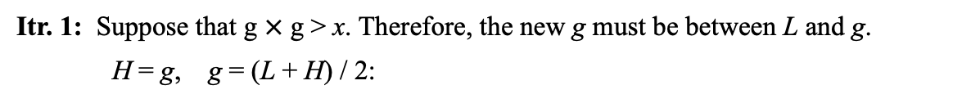
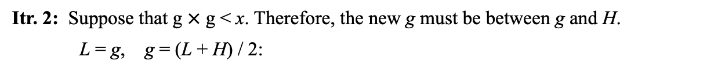
Bi-section search
Itr. 0: Initialize L = 1, H = x, g = (L + H) / 2:
L
g
H
1
x
L
g
H
x
1
L
g
H
x
We know that

Slide 7
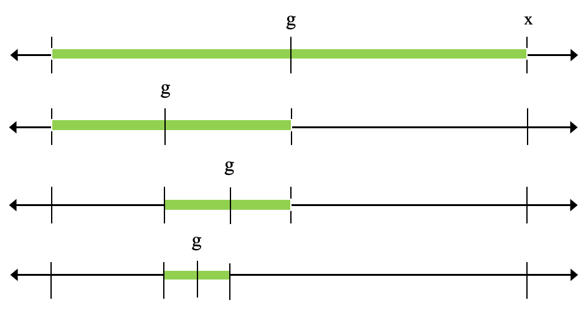
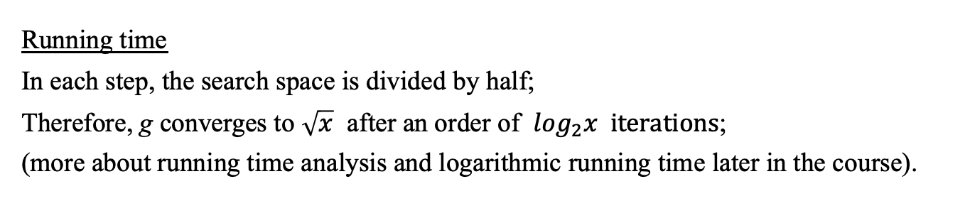
Bi-section search
Performance
In itr. 0, search space: x
In itr. 1, search space: x / 2
In itr. 2, search space: x / 4
In itr. 3, search space: x / 8
In itr. k, search space: x / 2^{k}
We know that

Slide 8

Bi-section search
// Computes an approximate square root by bi-section search
public class Sqrt2 {
public static void main(String args[]) {
double x = 16;
double epsilon = 0.01, L = 1.0, H = x;
double g = (L + H) / 2.0;
int stepCounter = 0;
while (Math.abs(g * g - x) >= epsilon) {
if (g * g < x)
L = g;
else
H = g;
g = (L + H) / 2;
stepCounter++;
}
System.out.println("Square root (approx.) = " + g);
System.out.println("Number of iterations = " + stepCounter);
}
}
abs
% java Sqrt2 (x = 16)
Square root (approx.) = 3.999267578125
Number of iterations = 11
% java Sqrt2 (x = 105)
Square root (approx.) = 10.2469482421875
Number of iterations = 15
Fast!

Slide 9
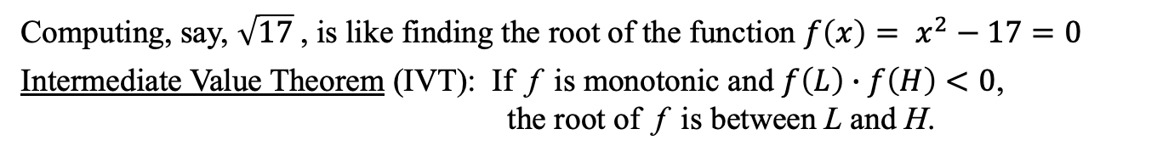
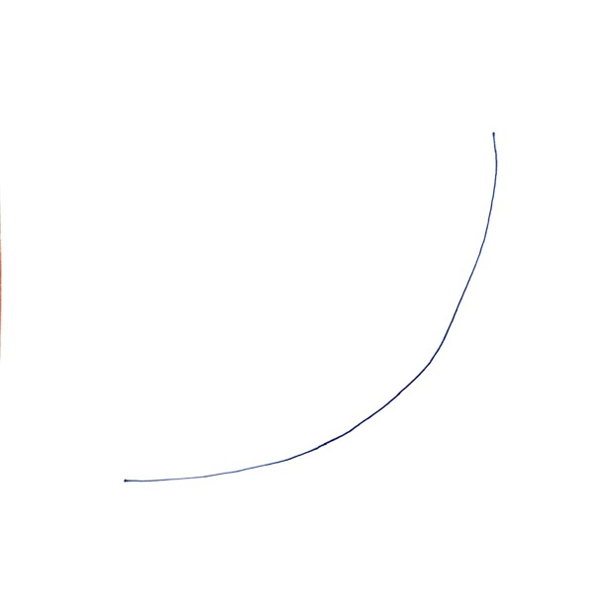





Bi-section search: Calculus intuition

Slide 10











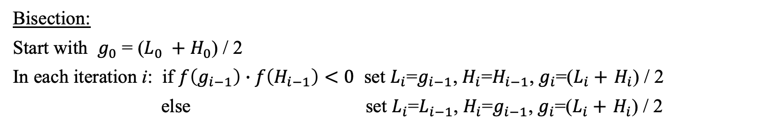
Bi-section search: Calculus intuition
iteration 0
iteration 1
iteration 2
etc...

Slide 11
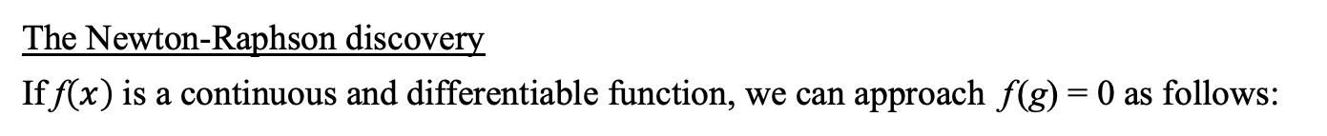

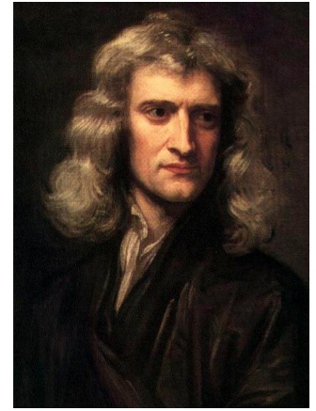

Newton – Raphson
Isaac Newton (1643 - 1727)

Slide 12


Newton – Raphson

Slide 13

Newton – Raphson

Slide 14

Newton – Raphson
These insights led to the discovery of such concepts as derivative (נגזרת), tangent (שיפוע), convergence (התכנסות), limit (גבול), ..., and the invention / discovery of modern Calculus.

Slide 15
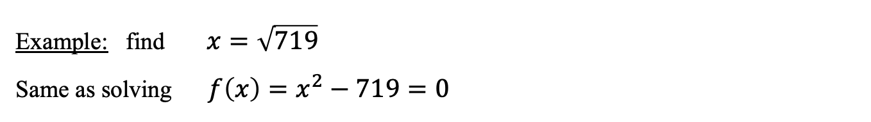
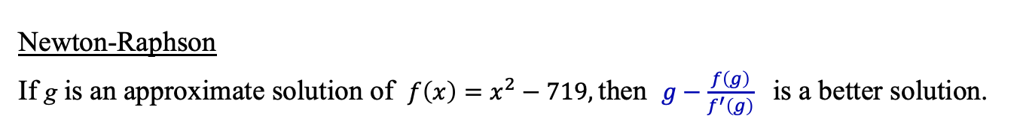
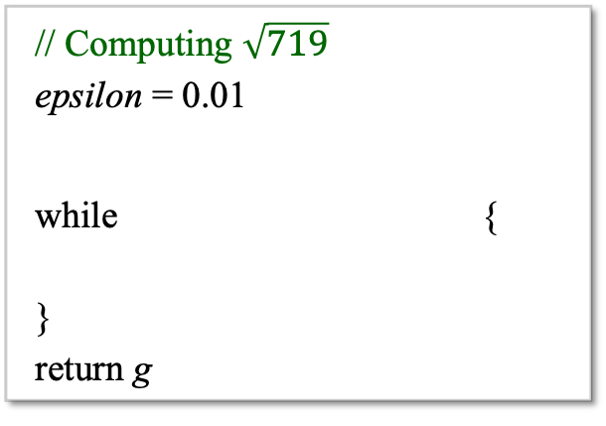


Newton – Raphson
Algorithm

Slide 16

Newton – Raphson
// Uses Newton-Raphson search to approximate sqrt(x).
public class Sqrt3 {
public static void main(String args[]) {
double x = 16;
double epsilon = 0.01;
int stepCounter = 0;
double g = x / 2;
while (Math.abs(g * g - x) > epsilon) {
g = g - (g * g - x) / (2 * g);
System.out.println("Step " + stepCounter + ": g = " + g);
stepCounter++;
}
System.out.println("Square root (approx.) = " + g);
}
}
Wow
% java Sqrt3 (x = 16)
Step 0: g = 5.0
Step 1: g = 4.1
Step 2: g = 4.001219512195122
Square root (approx.) = 4.001219512195122
% java Sqrt3 (x = 105)
Step 0: g = 27.25
Step 1: g = 15.551605504587156
Step 2: g = 11.151659989960418
Step 3: g = 10.283649283522411
Step 4: g = 10.247016247636102
Square root (approx.) = 10.247016247636102

Slide 17
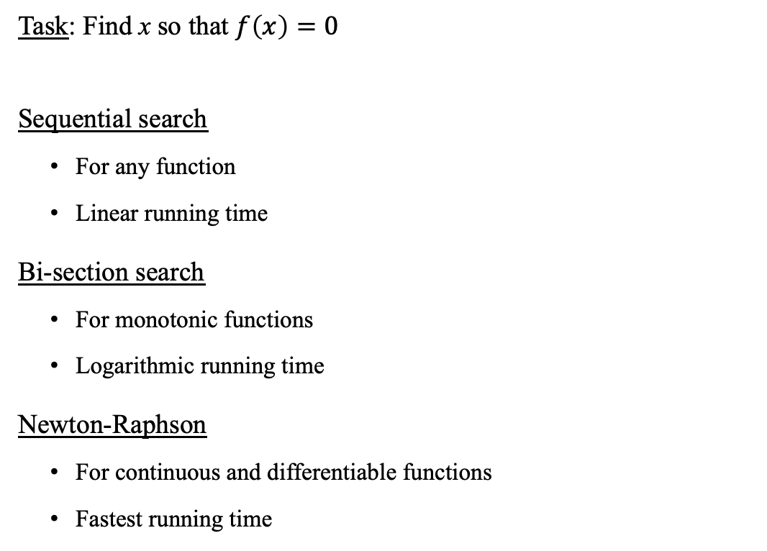
Approximation algorithms

Slide 18
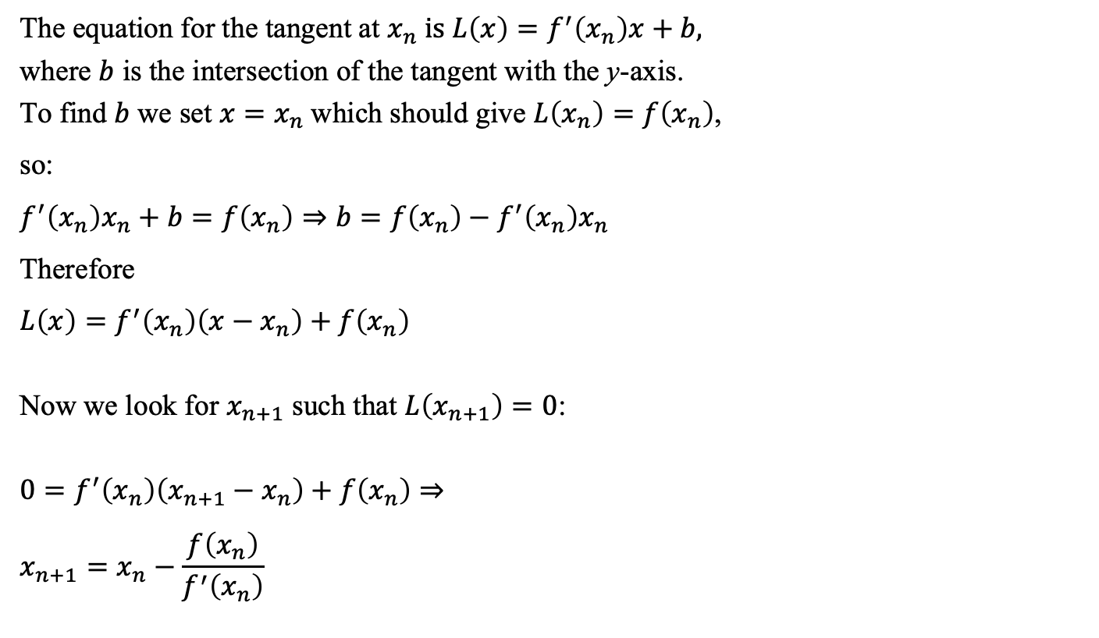
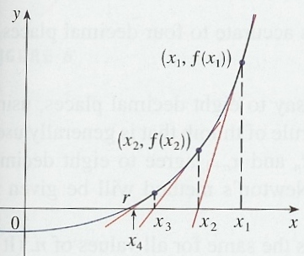
Newton – Raphson: proof (informal)

Slide 19

Introduction to Computer Science
Reichman University
Lecture 3-1
Functions
x
y
f (x, y, z)
z
f
(Functions in programming are related to, but quite different from, mathematical functions)
Notes:
‹#›

Slide 20
The big picture
any program you may want to write
objects
handling graphics, sound, and images
arrays
functions
conditionals and loops
Math
text I/O
primitive data types
variables

Slide 21
The big picture
any program you may want to write
objects
handling graphics, sound, and images
arrays
functions
this lecture
conditionals and loops
Math
text I/O
primitive data types
variables

Slide 22
Overview
public class Sqrt3 {
public static void main(String args[]) {
double x = Double.parseDouble(args[0]);
double epsilon = 0.01;
double g = x;
while (Math.abs(g * g - x) > epsilon) {
g = g - (g * g - x) / (2 * g);
}
System.out.println("Square root (approx.) = " + g);
}
}
Question
How can we make this computation accessible to any program that needs to compute square roots?
Answer
We can turn this computation into a reusable, stand-alone, function.
We’ll put this function, along with other mathematical functions, in a library named, say, MyMath

Slide 23
Overview
public class MyMath {
public static void main(String args[]) {
...
System.out.println(sqrt(x));
}
// Computes sqrt(x)
public static double sqrt(double x) {
double epsilon = 0.01;
double g = x;
while (Math.abs(g * g - x) > epsilon) {
g = g - (g * g - x) / (2 * g);
}
return g;
}
// Other library functions come here
}
function call
function declaration
Any other class
public class Foo {
public static void main(...) {
...
a = MyMath.sqrt(719);
...
}
}
return value
function call
A Java program normally consists of several classes
A public method can be called by any class
In a class like MyMath, which serves as a library of functions, a main method is not required
But, library classes often feature a main method designed to test / illustrate the library’s functions.

Slide 24
Overview
public class MyMath {
public static void main(String args[]) {
// Tests the square root function with various precisions:
System.out.println(Math.sqrt(2)); // benchmark value
System.out.println(sqrt(2, 0.5));
System.out.println(sqrt(2, 0.1));
System.out.println(sqrt(2, 0.001));
System.out.println(sqrt(2, 1e-7)); // 0.00000001
}
/** Computes square root with precision epsilon */
public static double sqrt(double x, double epsilon) {
if (x < 0) return Double.NaN;
double g = x;
while (Math.abs(g * g - x) > epsilon) {
g = g - (g * g - x) / (2 * g);
}
return g;
}
// More MyMath functions
}
% java MyMath
1.4142135623730951
1.5
1.4166666666666665
1.4142156862745097
1.4142135623746899
This version of sqrt takes epsilon as a parameter

Slide 25
Function anatomy
public static double sqrt(double x, double epsilon) {
if (x < 0) return Double.NaN;
double g = x;
while (Math.abs(g * g - x) > epsilon) {
g = g - (g * g - x) / (2 * g);
}
return g;
}

Slide 26
Function anatomy
type of return value
function name
parameter type
parameter name
function declaration
public static double sqrt(double x, double epsilon) {
if (x < 0) return Double.NaN;
double g = x;
while (Math.abs(g * g - x) > epsilon) {
g = g - (g * g - x) / (2 * g);
}
return g;
}
local
variable (g)
function
body
return value
A function
Takes zero, one, or more inputs (“arguments”)
Returns a value, which may be void
Has a type, which is the type of the returned value.

Slide 27
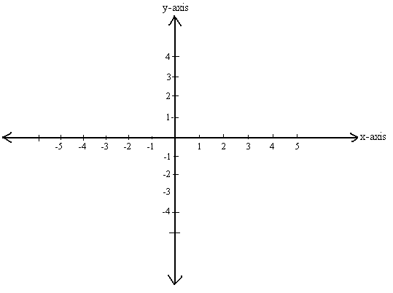


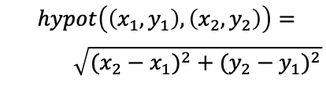
Function examples
public class MyMath {
public static void main(String args[]) {
/** Computes and prints a Euclidean distance */
double d = hypot(2,1,5,4);
System.out.println(d);
}
/** Computes the Euclidean distance between (x1,x2) and (y1,y1) */
public static double hypot(double x1, double y1,
double x2, double y2) {
double dx = x2 - x1;
double dy = y2 - y1;
return sqrt(dx*dx + dy*dy);
}
/** Computes sqrt(x) */
public static double sqrt(double x) {
double epsilon = 0.01;
double g = x;
while (Math.abs(g * g - x) > epsilon) {
g = g - (g * g - x) / (2 * g);
}
return g;
}
... // More functions come here
}
hypot
Euclidean distance
Widely used; Therefore, it makes sense to have a function that computes it
% java MyMath
4.242642472890547

Slide 28
Function examples
public class MyMath {
public static void main(String args[]) {
/** Computes and prints a Euclidean distance */
double d = hypot(2,1,5,4);
System.out.println(d);
}
/** Computes the Euclidean distance between (x1,x2) and (y1,y1) */
public static double hypot(double x1, double y1,
double x2, double y2) {
double dx = x2 - x1;
double dy = y2 - y1;
return sqrt(dx*dx + dy*dy);
}
/** Computes sqrt(x) */
public static double sqrt(double x) {
double epsilon = 0.01;
double g = x;
while (Math.abs(g * g - x) > epsilon) {
g = g - (g * g - x) / (2 * g);
}
return g;
}
... // More functions come here
}
Observations
Class: A collection of one or more methods
This particular class: A library of common math functions
The main method is often used to test/demo the other methods in the class.
% java MyMath
4.242642472890547

Slide 29
Calling a function
public class MyMath {
public static void main(String args[]) {
...
double d = hypot(2,1,5,4);
...
}
public static double hypot(double x1, double y1,
double x2, double y2) {
double dx = x2 - x1;
double dy = y2 - y1;
return sqrt(dx*dx + dy*dy);
}
public static double sqrt(double x) {
double epsilon = 0.01;
double g = x;
while (Math.abs(g * g - x) > epsilon) {
g = g - (g * g - x) / (2 * g);
}
return g;
}
...
}
Terminology
The calling function = caller
The called function = callee
main calls hypot
Calling a function:
The caller passes arguments to the callee
The caller suspends its execution, and waits for the callee to terminate
Control transfers to the callee, which starts executing.
hypot calls sqrt
sqrt calls Math.abs

Slide 30
Calling a function
public class MyMath {
public static void main(String args[]) {
...
double d = hypot(2,1,5,4);
...
}
public static double hypot(double x1, double y1,
double x2, double y2) {
double dx = x2 - x1;
double dy = y2 - y1;
return sqrt(dx*dx + dy*dy);
}
public static double sqrt(double x) {
double epsilon = 0.01;
double g = x;
while (Math.abs(g * g - x) > epsilon) {
g = g - (g * g - x) / (2 * g);
}
return g;
}
...
}
x1, x2, y1, y2, are initialized to 2, 1, 5, 4, respectively
x is initialized to the value of dx*dx + dy*dy
Terminology
Arguments:
The values that the caller passes
Parameters:
Similar to local variables; initialized by the arguments supplied by the caller.

Slide 31
Returning from a function call
public class MyMath {
public static void main(String args[]) {
...
double d = hypot(2,1,5,4);
...
}
public static double hypot(double x1, double y1,
double x2, double y2) {
double dx = x2 - x1;
double dy = y2 - y1;
return sqrt(dx*dx + dy*dy);
}
public static double sqrt(double x) {
double epsilon = 0.01;
double g = x;
while (Math.abs(g * g - x) > epsilon) {
g = g - (g * g - x) / (2 * g);
}
return g;
}
...
}
main calls hypot
When the callee returns:
The return value replaces the function call in the caller’s code
The caller continues its execution.
hypot calls sqrt
sqrt calls Math.abs

Slide 32
Function call and return: simulation
public class MyMath {
public static void main(String args[]) {
...
double d = hypot(2,1,5,4);
system.Out.println(d);
}
public static double hypot(double x1, double y1,
double x2, double y2) {
double dx = x2 - x1;
double dy = y2 - y1;
return sqrt(dx*dx + dy*dy);
}
public static double sqrt(double x) {
double epsilon = 0.01;
double g = x;
while (Math.abs(g * g - x) > epsilon) {
g = g - (g * g - x) / (2 * g);
}
return g;
}
...
}
% java MyMath
4.242642472890547

Slide 33
Function call and return: simulation
public class MyMath {
public static void main(String args[]) {
...
double d = hypot(2,1,5,4);
system.Out.println(d);
}
public static double hypot(double x1, double y1,
double x2, double y2) {
double dx = x2 - x1;
double dy = y2 - y1;
return sqrt(dx*dx + dy*dy);
}
public static double sqrt(double x) {
double epsilon = 0.01;
double g = x;
while (Math.abs(g * g - x) > epsilon) {
g = g - (g * g - x) / (2 * g);
}
return g;
}
...
}
1: MyMath.main starts running
2: main calls hypot
main suspends its execution
hypot starts running
3: hypot calls sqrt
hypot suspends its execution
sqrt starts running
1
2
2
3
3
% java MyMath
4.242642472890547
1

Slide 34
Function call and return: simulation
public class MyMath {
public static void main(String args[]) {
...
double d = hypot(2,1,5,4);
system.Out.println(d);
}
public static double hypot(double x1, double y1,
double x2, double y2) {
double dx = x2 - x1;
double dy = y2 - y1;
return sqrt(dx*dx + dy*dy);
}
public static double sqrt(double x) {
double epsilon = 0.01;
double g = x;
while (Math.abs(g * g - x) > epsilon) {
g = g - (g * g - x) / (2 * g);
}
return g;
}
...
}
1: MyMath.main starts running
2: main calls hypot
main suspends its execution
hypot starts running
3: hypot calls sqrt
hypot suspends its execution
sqrt starts running
4: sqrt returns
hypot resumes its execution
the next executed instruction: return (the value that sqrt returned)
5: hypot returns
main resumes its execution
the next executed instruction: d = (the value that hypot returned)
6: MyMath.main prints, and then returns; the program terminates.
1
2
2
6
3
5
3
4
5
4
6
% java MyMath
4.242642472890547
1

Slide 35
Overloading
public class MyMath {
public static void main(String args[]) {
...
System.out.println(sqrt(2, 0.1));
System.out.println(sqrt(2, 0.001));
System.out.println(sqrt(2));
...
}
/** Square root of x with precision epsilon */
public static double sqrt(double x, double epsilon) {
if (x < 0) return Double.NaN;
double g = x;
while (Math.abs(g * g - x) > epsilon) {
g = g - (g * g - x) / (2 * g);
}
return g;
}
}
% java MyMath
1.4166666666666665
1.4142156862745097
1.4142156862745097
Huh?

Slide 36
Overloading
public class MyMath {
public static void main(String args[]) {
...
System.out.println(sqrt(2, 0.1));
System.out.println(sqrt(2, 0.001));
System.out.println(sqrt(2));
...
}
/** Square root of x with precision epsilon */
public static double sqrt(double x, double epsilon) {
if (x < 0) return Double.NaN;
double g = x;
while (Math.abs(g * g - x) > epsilon) {
g = g - (g * g - x) / (2 * g);
}
return g;
}
/** Square root of x with default precision 0.001 */
public static double sqrt(double x) {
return sqrt(x, 0.001);
}
}
Function signature
Consists of:
The number of the function’s parameters;
The types of the function’s parameters.
Overloading
Defining functions that have the same name, but different signatures
Note: These are different functions
Usage
Overloading is widely used
Supports many different needs
In this example: Overloading is used to implement a computation that has both a default precision, and a user-defined precision.

Slide 37
Overloading: Example 2
// List of println method overloads in Java:
void println()
// Terminates the current line by writing the line separator string.
void println(boolean x)
// Prints a boolean and then terminates the line.
void println(char x)
// Prints a character and then terminates the line.
void println(char[] x)
// Prints an array of characters and then terminates the line.
void println(double x)
// Prints a double and then terminates the line.
void println(float x)
// Prints a float and then terminates the line.
void println(int x)
// Prints an integer and then terminates the line.
void println(long x)
// Prints a long and then terminates the line.
void println(Object x)
// Prints an Object and then terminates the line.
void println(String x)
// Prints a String and then terminates the line.
(Java’s println function API)
Here overloading is used to create a printing service that can be used to print many different data types using “the same” println function.

Slide 38
Overloading: Example 3
// List of indexOf method overloads in Java:
int indexOf(int ch)
// Returns the index within this string of the first occurrence of the specified character.
int indexOf(int ch, int fromIndex)
// Returns the index within this string of the first occurrence of the specified character,
// starting the search at the specified index.
int indexOf(String str)
// Returns the index within this string of the first occurrence of the specified substring.
int indexOf(String str, int fromIndex)
// Returns the index within this string of the first occurrence of the specified substring,
// starting at the specified index.
(Java’s indexOf function API)
str = "It was the best of time";
System.out.println(str.indexOf('t')); // prints 1
System.out.println(str.indexOf('t',3)); // prints 7
System.out.println(str.indexOf("best")); // prints 11
Here overloading is used to feature different variants of “the same” indexOf function.

Slide 39
Modularity
Modularity: Dividing a program into several modules
public class MyMath {
public static void main(String args[]) {
double d = hypot(2,1,5,4);
System.out.println(d);
}
/** Euclidean distance between (x1,x2) and (y1,y1) */
public static double hypot(double x1, double y1, double x2, double y2) {
double dx = x2 - x1;
double dy = y2 - y1;
return sqrt(dx*dx + dy*dy);
}
// Computes sqrt(x)
public static double sqrt(double x) {
double epsilon = 0.01;
double g = x;
while (Math.abs(g * g - x) > epsilon) {
g = g - (g * g - x) / (2 * g);
}
return g;
}
...
}
Benefits
Reduces:
code complexity
redundant code (errors)
Enables:
code reuse
unit testing
maintenance
parallel development.

Slide 40
Modularity
Modularity: Dividing a program into several modules
public class MyMath {
public static void main(String args[]) {
double d = hypot(2,1,5,4);
System.out.println(d);
}
/** Euclidean distance between (x1,x2) and (y1,y1) */
public static double hypot(double x1, double y1, double x2, double y2) {
double dx = x2 - x1;
double dy = y2 - y1;
return sqrt(dx*dx + dy*dy);
}
// Computes sqrt(x)
public static double sqrt(double x) {
double epsilon = 0.01;
double g = x;
while (Math.abs(g * g - x) > epsilon) {
g = g - (g * g - x) / (2 * g);
}
return g;
}
...
}
Methods in one class can call public methods in other classes:
public class Foo {
...
System.out.println(MyMath.hypot(2,1,5,4));
...
double q = MyMath.sqrt(54267);
...
}
Method calling syntax
If the callee is in the same class: functionName(argument list)
If the callee is in a different class: ClassName.functionName(argument list)

Slide 41
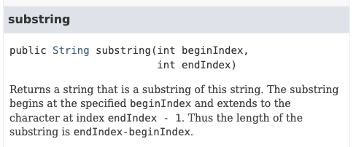
API
Substring API:
public class Foo {
...
String s = str.substring(3,5);
...
}
substring
The caller’s perspective
When I call a function:
I view and use the function as a black box abstraction
I don’t care how it is implemented
I care only how to use it
All I need is the function’s API For example: I use a search engine / chatbot to review the “String class Java Oracle API”
API: “Application Programming Interface”:
Documents the function’s interface
Explains how to use the function
Focuses on the caller’s perspective
Written by the function’s developer / architect.

Slide 42

Typical roles in software development
Class skeleton
public class MyMath {
public static void main(String args[]) {
double d = hypot(2,1,5,4);
System.out.println(d);
}
/** Euclidean distance between (x1,x2) and (y1,y1) */
public static double hypot(double x1, double y1, double x2, double y2) {
return 0;
}
// Computes sqrt(x)
public static double sqrt(double x) {
return 0;
}
...
}
System architects
Write class skeletons:
Method signatures
API documentation
Standard tests
Developers
Implement the functions, adds more tests, as needed
Testers
Test everything.
Some examples (approx. / initial product)
Chrome: 100 developers
Slack: 20
Whatsapp: 30
Minecraft: 1
Linux: 1 architect, thousands developers

